Slide 1

Mini Project Review-II on SOLAR BACKPACK
Under the esteemed guidance of
Mr P. Ravi Kumar Reddy
Assistant Professor
By
Kodati Akshitha 1608-20-735-012
Jahanavi .N 1608-20-735-308
T.Harshavardhan 1608-20-735-020
Department of Electronics and Communication Engineering
(ACCEDIATED by NAAC A+ and NBA)
MATRUSRI ENGINEERING COLLEGE
(Sponsored by Matrusri Education Society, Estd1980)
(Approved by AICTE, Affiliated to Osmania University)
#16-1-486, Saidabad, Hyderabad, Telangana-500 059
www.matrusri.edu.in
2022-23
Notes:
1

Slide 2
CONTENTS
Introduction
Literature Survey
Problem Statement
Objective
Block Diagram
Working Principal Explanation
Components Description
Applications
References

Slide 3
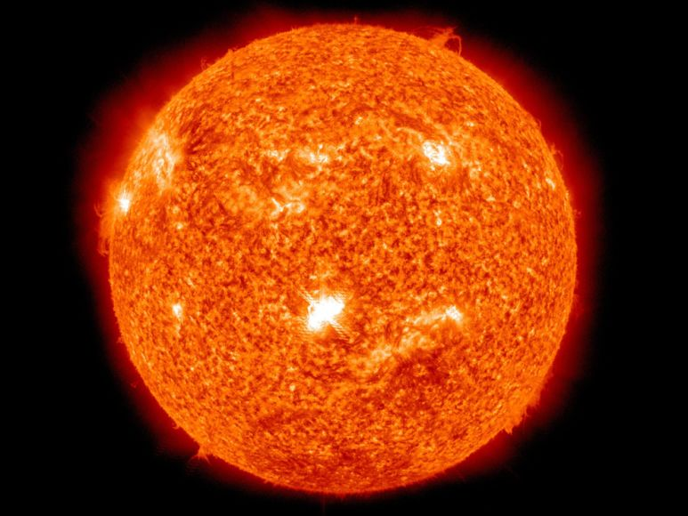
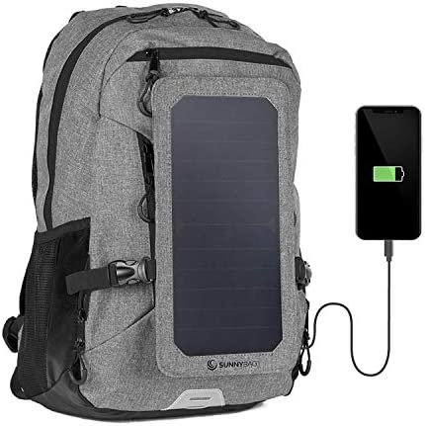
Introduction
Solar is one of the most abundant sources of renewable energy with the potential capability of generating enough power to meet the demands of the entire planet. It was calculated theoretically that the amount of sun received on earth for one day can meet the demand of the world for more than 20 years
One product that utilises solar energy is a solar-powered backpack. This backpack is used as a mobile charger, switch-based LED light, and Bluetooth speaker.

Slide 4
Literature Survey
S.no | Paper | Description
1 | R. Ramakumar, H. J. Allison and W. L. Hughes, "Solar energy conversion and storage systems for the future," in IEEE Transactions on Power Apparatus and Systems, vol. 94, no. 6, pp. 1926-1934, Nov. 1975, doi: 10.1109/T-PAS.1975.32038. | The thesis of this paper is that the long-range solution to the energy woes of the world does not lie in any one particular approach and that several avenues should be explored simultaneously, with particular emphasis on the exploitation of solar energy in its various manifestations such as heat, winds, tides, and ocean thermal gradients.
2 | Z. Muhseen et al., "Portable Smart Solar Panel for Consumer Electronics," 2020 International Conference on Smart Technologies in Computing, Electrical and Electronics (ICSTCEE), 2020 | This paper describes a foldable and portable solar charger that can be utilized for charging many devices. It has a compact size and includes facilities such as GPS tracking, and provision to charge both ac and dc appliances.
3 | D. Redfield, "Solar energy and conservation," in Technology and Society, vol. 6, no. 23, pp. 4-9, Sept. 1978, doi: 10.1109/TS.1978.6500361. | Any list of the motivations for energy conservation — increasing scarcity and price of fuels, environmental and health consequences of large-scale fuel consumption, foreign trade deficit, vulnerability of imported fuel supply, nuclear weapons proliferation and help to the third world — is precisely the same list of reasons for using renewable, indigenous energy sources
4 | J. Liu, J. Wang, Z. Tan, Y. Meng and X. Xu, "The analysis and application of solar energy PV power," 2011 International Conference on Advanced Power System Automation and Protection, 2011, pp. 1696-1700, doi: 10.1109/APAP.2011.6180758. | Solar power is an important measure to improve the energy structure, so PV power application becomes an important research field. Based on the application of solar power in the high-speed railway stations and the canopy architectural design, this paper makes a comparison between independent system and grid-connected system and solar battery comparison, thoroughly studies the PV power in domestic railway stations and proposes two schemes of monocrystalline silicon panel grid-connected system and amorphous silicon thin film panels grid system

Slide 5
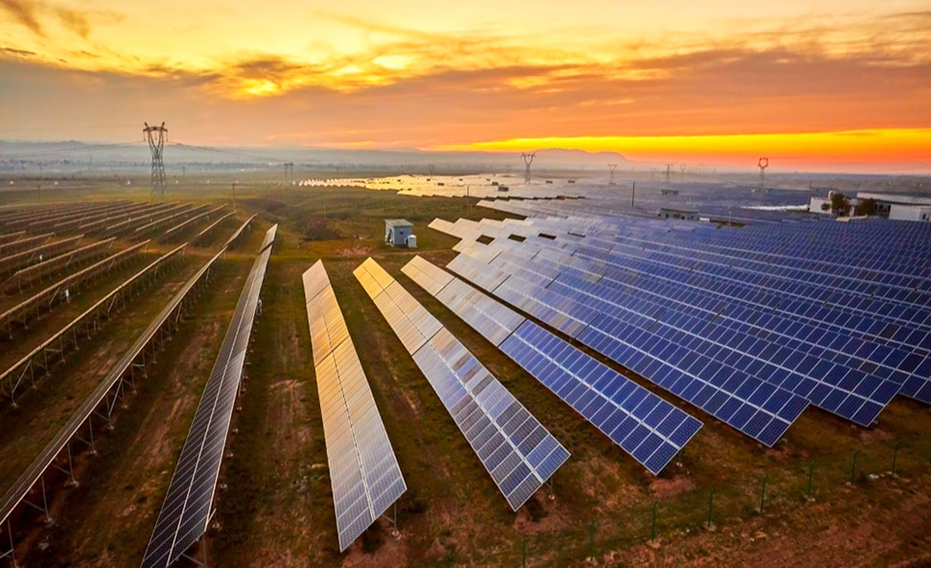
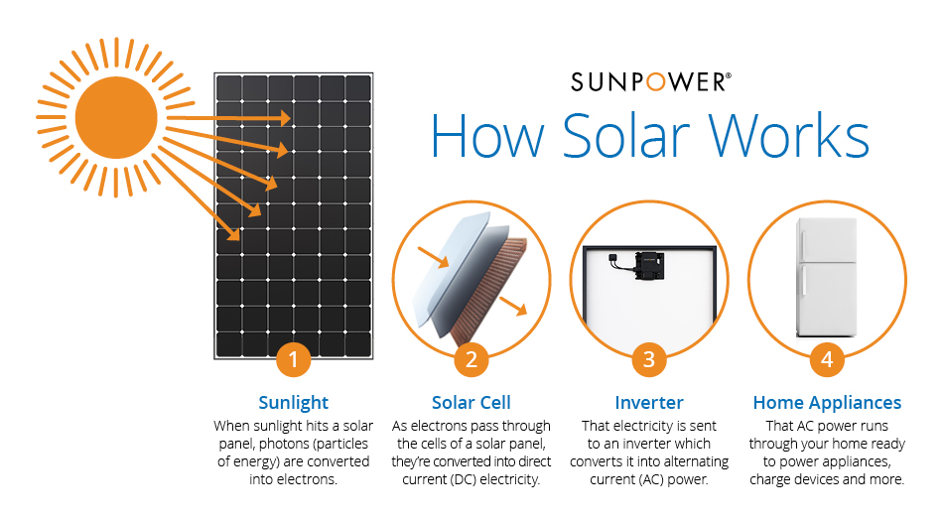
Problem Statement
The purpose of the project is to develop a different prototype of a solar-powered charging backpack that is capable of charging a mobile phone, switch-based LED light along with Bluetooth speakers.
The design would have to meet certain criteria including durability, reliability, practicality and low cost. For this to be achieved successfully, research, design, testing and analysis are carried out

Slide 6

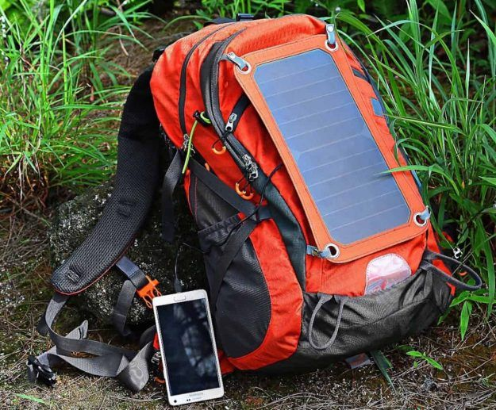
Objective
Design a smart and compact solar-powered backpack with switch-based LED and Bluetooth speaker capability to make use of solar energy to achieve conservation of energy while at the same time making life easy.
Notes:
6

Slide 7
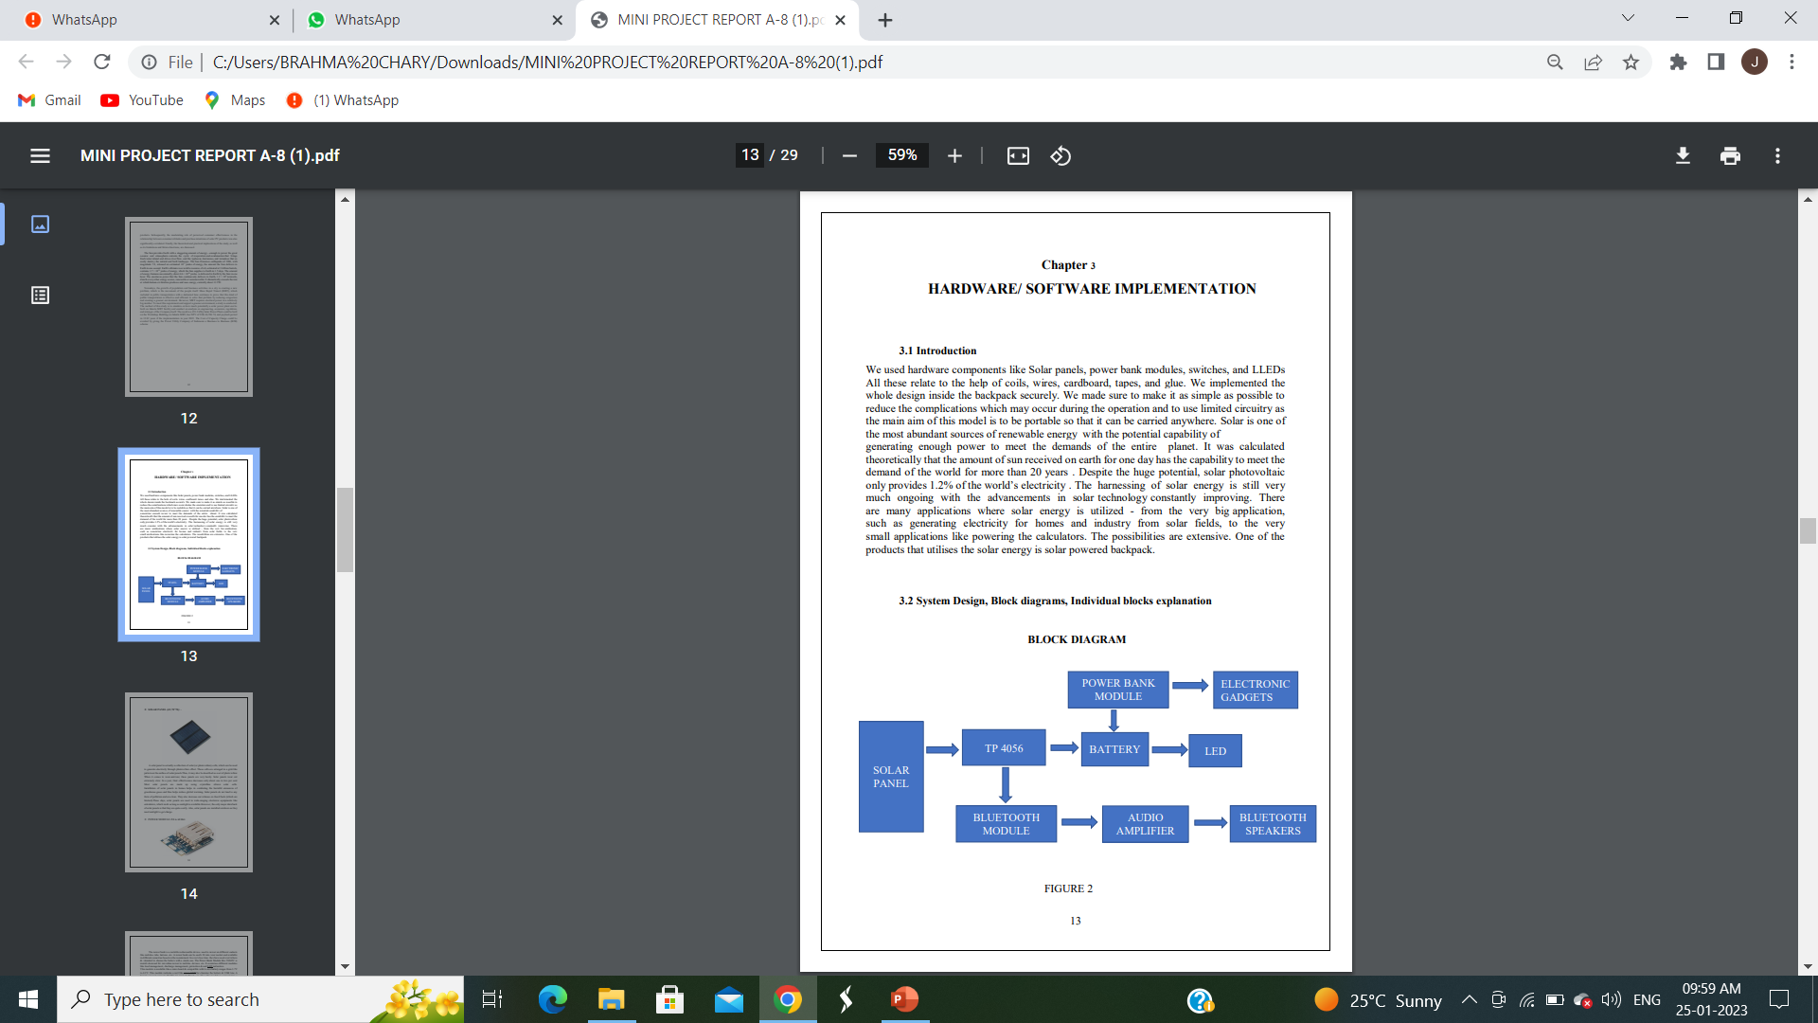
BLOCK DIAGRAM

Slide 8
Working principle
To figure out how a solar-powered backpack works, we need to understand a little bit about the mechanics of the solar-powered backpack, or solar technology.
It may seem complicated, but it's really pretty simple -- photovoltaic (PV) cells are what make it all happen.
The cells, grouped together as modules or panels, collect light from the sun and convert it to usable electricity.
­When sunlight hits a solar panel, the silicon semiconductor absorbs a portion of the light and its energy.
Electric fields in the photovoltaic cells wrangle those electrons and force them to flow in one direction like a cattle rancher guiding his head.
This creates an electric current that can be harnessed by attaching metal contact points at the top and bottom of the PV cell.
Once the energy is collected, it can be used immediately as electricity or stored in a battery or series of batteries for later use.

Slide 9
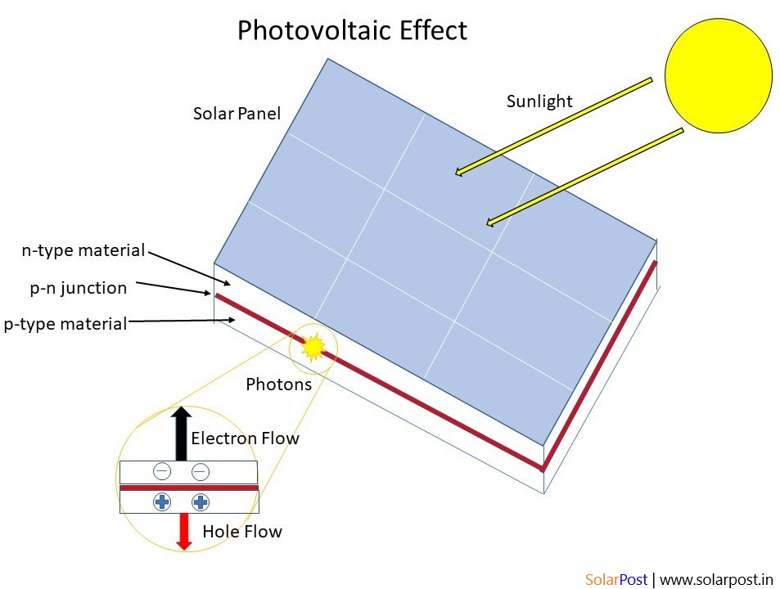

Slide 10
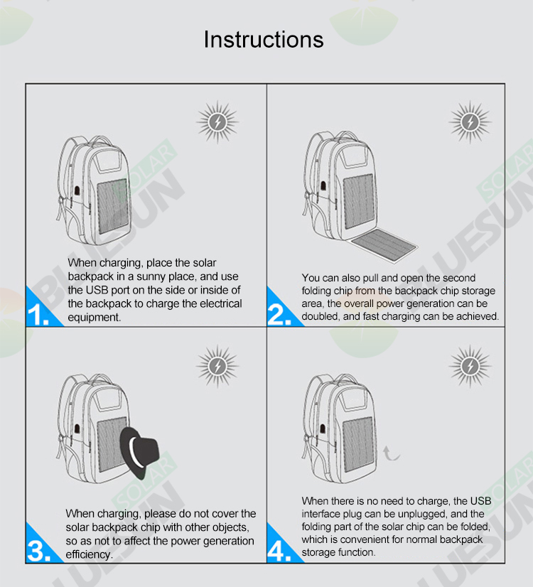

Slide 11
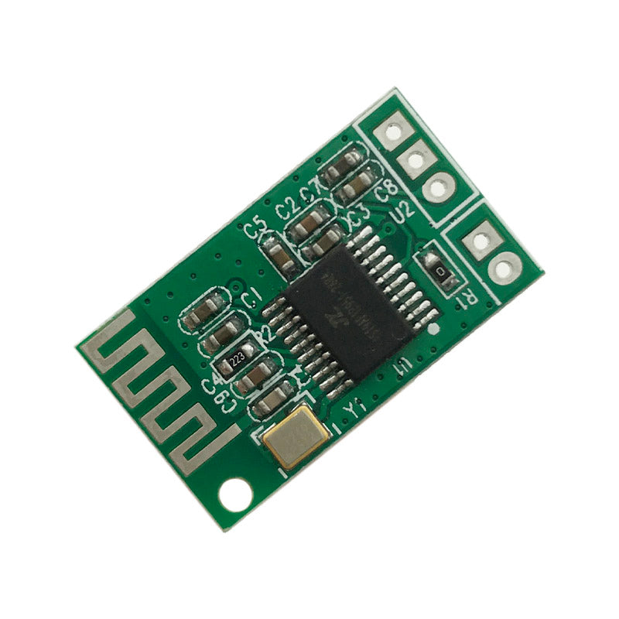
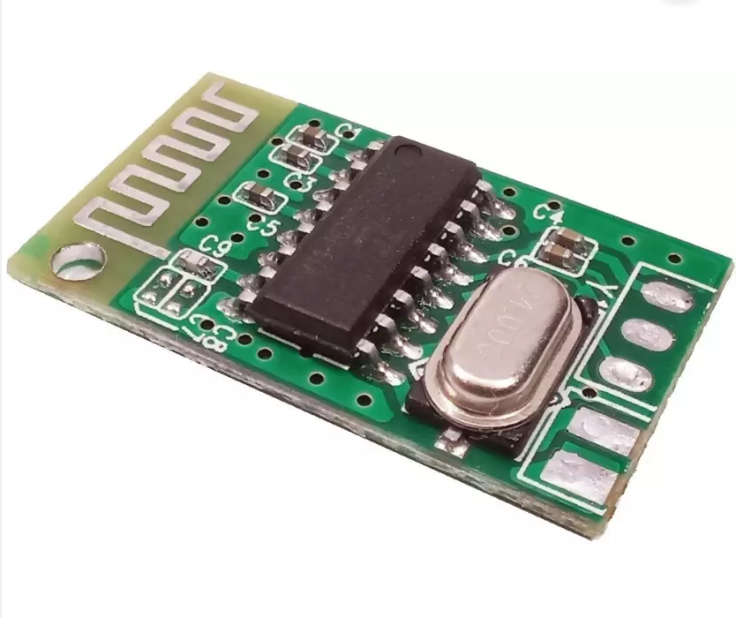
5 v Bluetooth Module
This is a Bluetooth audio receiver module, which means it can receive the audio signal of MP3 and other popular formats.
It's very easy to connect and operate, and once connected to the other Bluetooth device like your phone or laptop etc.
It can receive the signal and convert it into the output form which is compatible with the speakers. It has 3 output terminals L Out, R Out and GND to which you can directly connect your wired earphone using a 3.5mm female jack or if you want to drive a big speaker you can connect its output to the input of a good amplifier system.

Slide 12
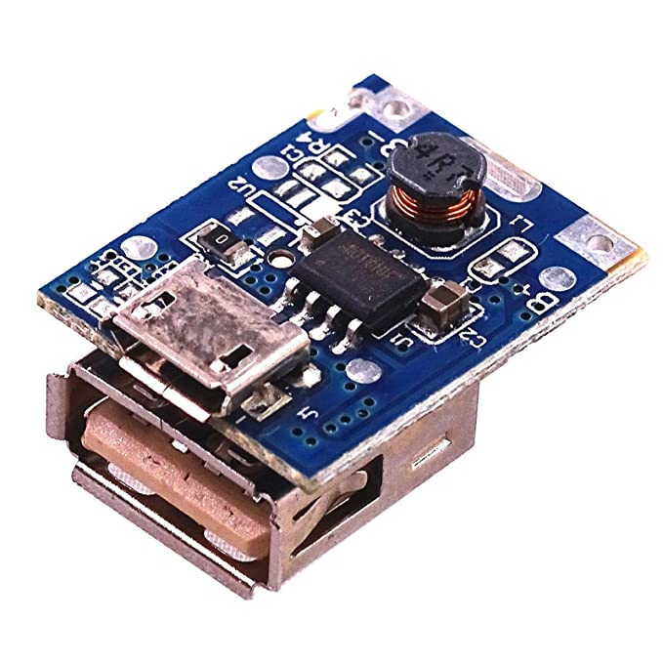
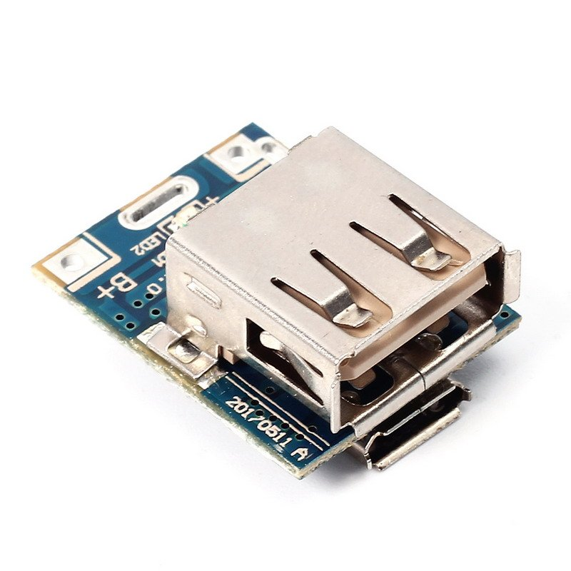
Power Bank Charging Module
Power Bank Module is a supermini power bank mainboard compatible with 3.7V-4.2V li-ion battery. On-board micro USB port for battery charging and USB type A female output port supporting DC 5V 1A input and 5V 1A output. Just connect it to a 18650 battery then you can get a portable power bank.

Slide 13
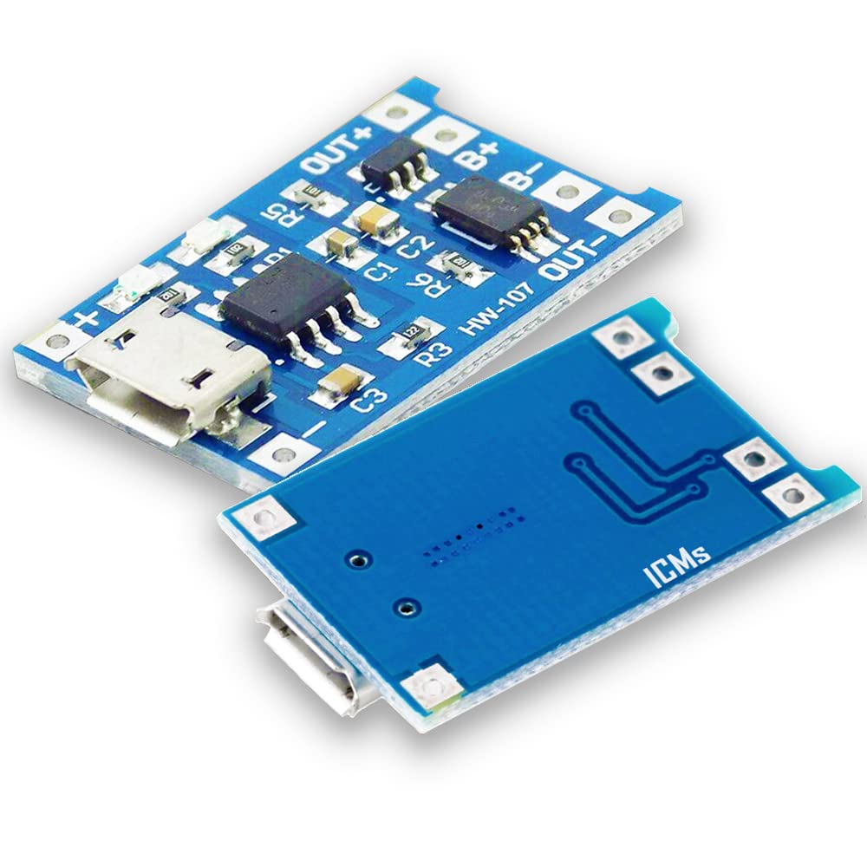
TP 4056 MODULE
The TP4056 chip is a lithium Ion battery charger for a single cell battery, protecting the cell from over and under charging. It has two status outputs indicating charging in progress, and charging complete. It also has a programmable charge current of up to 1A.
You can use it to charge batteries directly from a USB port since the working input voltage range is 4V ~ 8V. However, remember the maximum current from a USB port is 500mA.

Slide 14
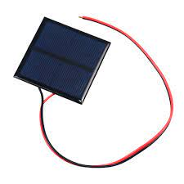
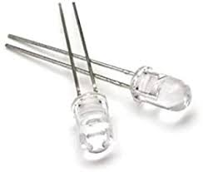
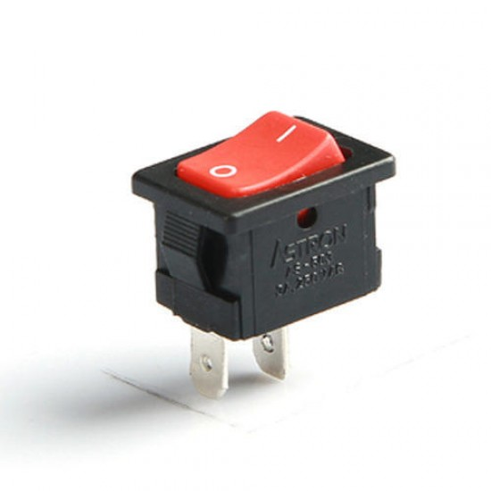
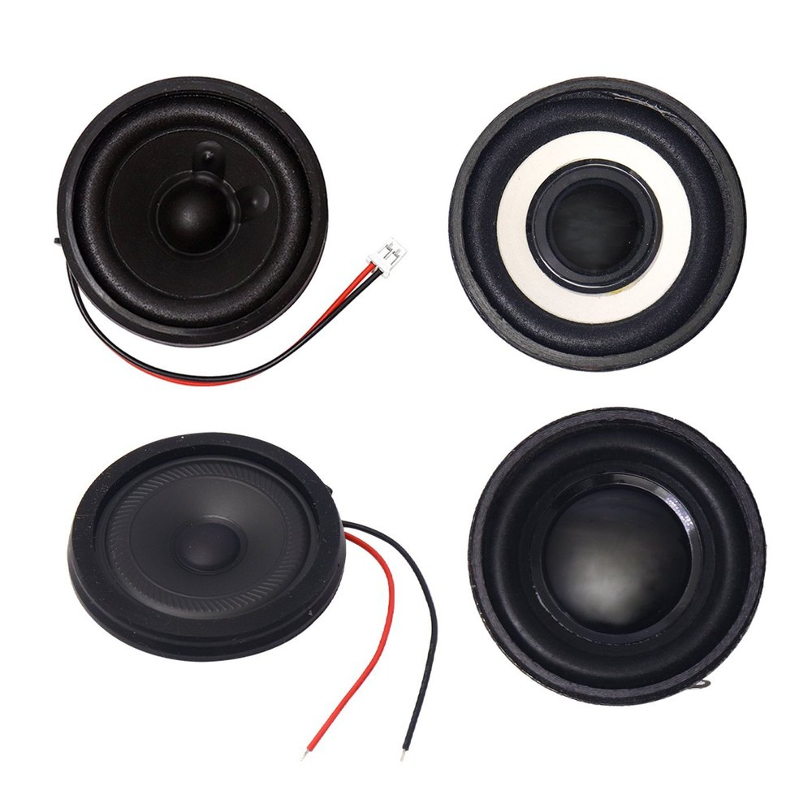
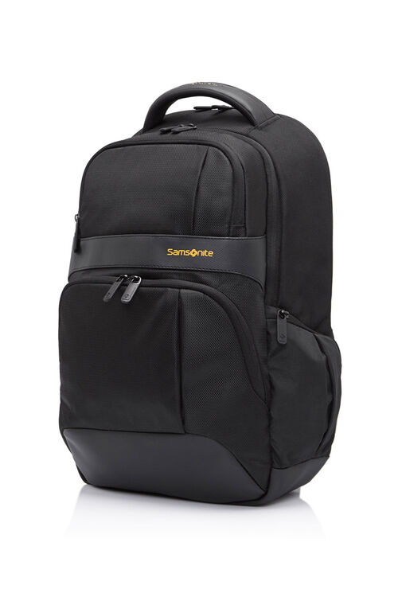
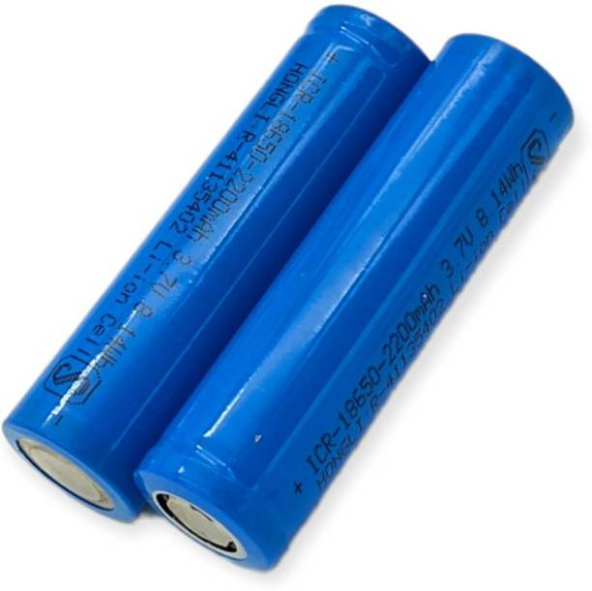
5. Activity – Every cell is unique

Slide 15
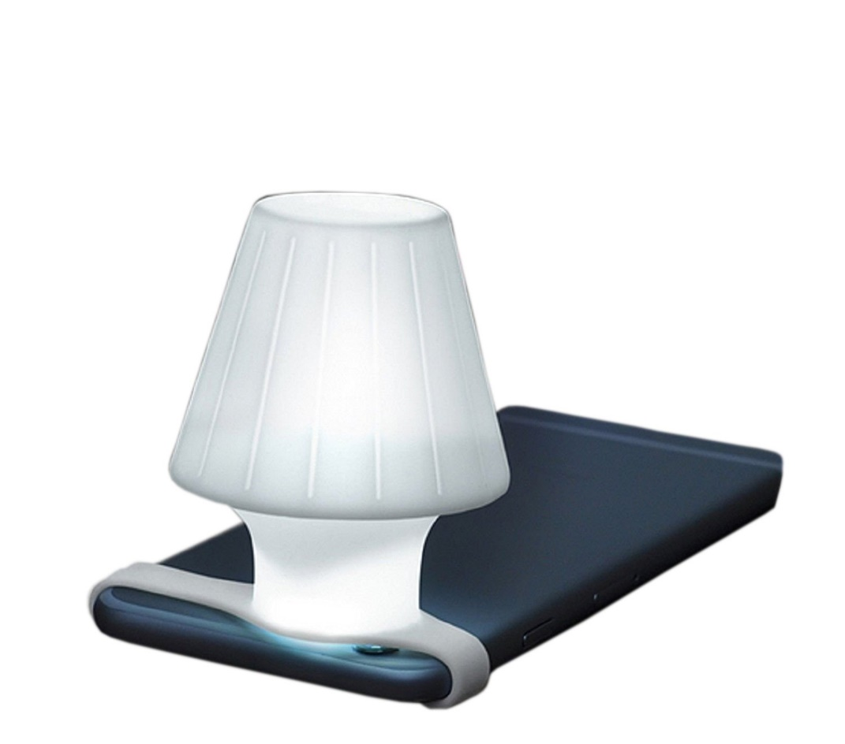
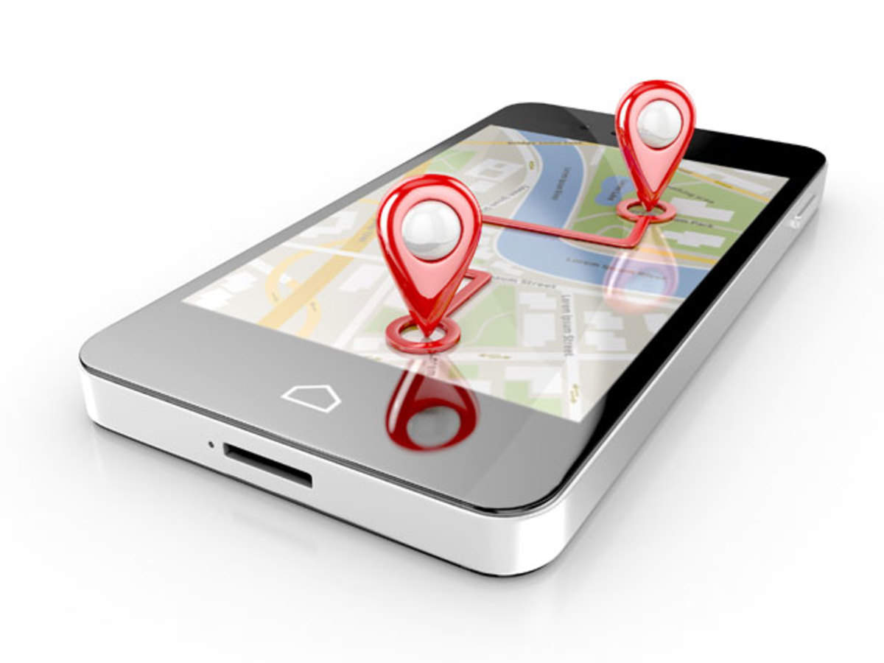
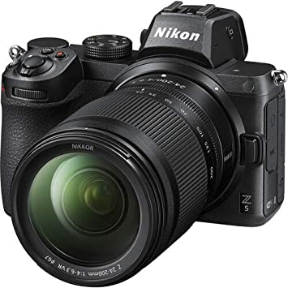
Applications
Powering a GPS system
A travel lamp
A digital camera
A palm pilot
LED switching
Bluetooth speaker switching
and other rechargeable electronic devices.

Slide 16
References
Harvindar Singh Gambhir, Dattatray Sawant, Abhishek Basu, "IIoT Based Automation In Doorstep Fuel Delivery System", 2022 10th International Conference on Emerging Trends in Engineering and Technology - Signal and Information Processing (ICETET-SIP-22), pp.1-6, 2022.
G. H. Raghunandan, Ambika Rani Subhash, Akanksha V. Ghat, D Swetha, Chandana Nagaraj, R Hema, "Quantitative Analysis of Sustainable Energy Based Charging Systems", 2022 6th International Conference on Devices, Circuits and Systems (ICDCS), pp.53-57, 2022.
L. Dexter, C. Mario and M. Gallego Jeffrey, "Design and Implementation of 4- In-1 Luggage Bag", International Journal for Research in Applied Science & Engineering Technology (IJRASET), vol. 5, no. XI, pp. 272-278, November 2017.
Shubham Sarkar, Suvojit Manna and Subhadeep Datta, "Smart Bag Tracking and Alert System using RFID", International Conference on Electrical Electronics Communication Computer and Optimization Techniques (ICEECCOT), 2017.
Shweta Ma and Tanvi Pb, "Multipurpose Smart Bag", Procedia Computer Science 79, pp. 77-84, 2016.

Slide 17


